Slide 1
ORACLE SQL/PLUS
eric@the-ecg.com

Slide 2
SQL Statement
ALTER – Change an existing table, view or index definition (DDL)
AUDIT – Track the changes made to a table (DDL)
COMMENT – Add a comment to a table or column in a table (DDL)
COMMIT – Make all recent changes permanent (DML – transactional)
CREATE – Create new database objects such as tables or views (DDL)
DELETE – Delete rows from a database table (DML)
DROP – Drop a database object such as a table, view or index (DDL)
GRANT – Allow another user to access database objects such as tables or views (DDL)
INSERT – Insert new data into a database table (DML)
No AUDIT – Turn off the auditing function (DDL)
REVOKE – Disallow a user access to database objects such as tables and views (DDL)
ROLLBACK – Undo any recent changes to the database (DML – Transactional)
SELECT – Retrieve data from a database table (DML)
TRUNCATE – Delete all rows from a database table (can not be rolled back) (DML)
UPDATE – Change the values of some data items in a database table (DML)

Slide 3
Create User and Copy Table #1
CONNECT SYSTEM/MIS12345; -> dba
CREATE USER TEST(id) IDENTIFIED BY TEST1234(비번);
GRANT DBA TO TEST;
GRANT CONNECT TO TEST;
CONNECT TEST/TEST1234;
CONNECT TEST/TEST1234;
ALTER USER SCOTT IDENTIFIED BY TIGER;
CONNECT SCOTT/TIGER;
DESC USER_TABLES;
SELECT TABLE_NAME FROM USER_TABLES;
CONNECT TEST/TEST1234;
Oracle default table : user_tabels , dba_tables, dba_users, user_users;

Slide 4
Create User and Copy Table #2
CREATE TABLE EMP AS SELECT * FROM SCOTT.EMP;
SELECT * FROM EMP;
CREATE TABLE DEPT AS SELECT * FROM SCOTT.DEPT;
CREATE TABLE BONUS AS SELECT * FROM SCOTT.BONUS;
CREATE TABLE SALGRADE AS SELECT * FROM SCOTT.SALGRADE;

Slide 5
CREATE TABLE, DESCRIBE #1
CREATE TABLE employee1
(employeeid VARCHAR2(9) NOT NULL,
fname VARCHAR2(8),
minit VARCHAR2(2),
lname VARCHAR2(8),
bdate DATE,
address VARCHAR2(27),
sex VARCHAR2(1),
salary NUMBER(7) NOT NULL,
superempid VARCHAR2(9),
dno NUMBER(1) NOT NULL) ;
DESCRIBE employee1;

Slide 6
CREATE TABLE, DESCRIBE #2
CREATE TABLE emp_department_1
AS SELECT fname, minit, lname, bdate
FROM employee1 WHERE dno = 1 ;
DESCRIBE emp_department_1
CREATE TABLE high_pay_emp
AS SELECT *
FROM emp
WHERE sal > 1500 ;
Select count(*) from high_pay_emp;

Slide 7
COPY TABLE DEFINITION
CREATE TABLE copy_of_employee
AS SELECT *
FROM emp
WHERE 3=5 ;
DESCRIBE copy_of_employee

Slide 8
REFERENTIAL INTEGRITY #1
DROP TABLE department1;
CREATE TABLE department
(dnumber NUMBER(1),
dname VARCHAR2(15),
mgrempid VARCHAR2(9),
mgrstartdate DATE,
CONSTRAINT pk_department PRIMARY KEY (dnumber) );

Slide 9
REFERENTIAL INTEGRITY #2
CREATE TABLE employee2
(employeeid VARCHAR2(9) NOT NULL,
fname VARCHAR2(8),
minit VARCHAR2(2),
lname VARCHAR2(8),
bdate DATE,
address VARCHAR2(27),
sex VARCHAR2(1),
salary NUMBER(7) NOT NULL,
superempid VARCHAR2(9),
dno NUMBER(1) NOT NULL,
CONSTRAINT pk_employee PRIMARY KEY (employeeid),
CONSTRAINT fk_department FOREIGN KEY (dno)
REFERENCES department (dnumber) ON DELETE CASCADE);

Slide 10
REFERENTIAL INTEGRITY #3
insert into employee2 values
('123456789', 'Joe', 'M', 'Smith', '01-JUN-45',
'123 Smith St.', 'm', 45000, '123456789', 1) ;
Select sysdate from dual;
insert into employee2 values
('123456789', 'Joe', 'M', 'Smith', '45/06/01',
'123 Smith St.', 'm', 45000, '123456789', 1) ;
Insert into department values ('1', 'test', '','');
insert into employee2 values
('123456789', 'Joe', 'M', 'Smith', '45/06/01',
'123 Smith St.', 'm', 45000, '123456789', 1) ;

Slide 11
ALTER TABLE
DESCRIBE emp_department_1
ALTER TABLE emp_department_1
ADD (manager VARCHAR2(8)) ;
ALTER TABLE emp_department_1
MODIFY (fname VARCHAR2(15));
DESCRIBE emp_department_1

Slide 12
DBA Privillege
CREATE VIEW vw_emp_dno_1
AS SELECT fname, lname, dno
FROM employee1
WHERE dno = 1;
CONNECT SYSTEM/Tiger123;
GRANT dba to scott;
CONNECT scott/Tiger123;

Slide 13
CREATE VIEW
CREATE VIEW vw_emp_dno_1
AS SELECT fname, lname, dno
FROM employee1
WHERE dno = 1;
SELECT * FROM vw_emp_dno_1 ;
DROP VIEW vw_emp_dno_1 ;
CREATE VIEW vw_dept_average_salary AS
SELECT dnumber, dname, AVG(salary) AS average_salary
FROM department, employee1
WHERE emp.dno = department.dnumber
GROUP BY dnumber, dname ;
SELECT * FROM vw_dept_average_salary ;

Slide 14
CREATE SEQUENCES
CREATE SEQUENCE seq_department_number
START WITH 1
MAXVALUE 9999
NOCYCLE;
SELECT seq_department_number.nextval FROM dual ;
INSERT INTO department VALUES
(seq_department_number.nextval, 'Finance',
'123456789', '1999-01-01');
SELECT sequence_name, min_value, max_value, last_number
FROM USER_SEQUENCES ;
DROP SEQUENCE seq_department_number ;

Slide 15
CREATE SYNONYM
SELECT * FROM scott.employee1;
CREATE SYNONYM employees2 FOR scott.employee1;
SELECT * FROM employees2 ;

Slide 16
UPDATE, ROLLBACK
SELECT * FROM employee2 where dno=1;
UPDATE employee2
SET salary = salary * 1.04
WHERE dno = 1;
SELECT * FROM employee2 where dno=1;
ROLLBACK ;
SELECT * FROM employee2 where dno=1;

Slide 17
INSERT, COMMIT
UPDATE employee2
SET salary = salary * 1.03
WHERE dno =
(SELECT dno
FROM department
WHERE dname = 'MARKETING');
INSERT INTO employee2
VALUES ('123456789', 'JOHN', 'B', 'SMITH', '1975-01-09',
'731 FONDREN, HOUSTON, TX', 'M', 30000, '333445555', 5) ;
INSERT INTO employee2
VALUES ('123456788', 'JOHN', 'B', 'SMITH', '1975-01-09',
'731 FONDREN, HOUSTON, TX', 'M', 30000, '333445555', 1) ;
COMMIT ;

Slide 18
USING SYSTEM CATALOG
SELECT table_name FROM USER_TABLES ;
SELECT constraint_name, constraint_type, table_name
FROM user_constraints ;
SELECT view_name FROM user_views ;
SELECT synonym_name, table_owner, table_name FROM USER_SYNONYMS ;

Slide 19
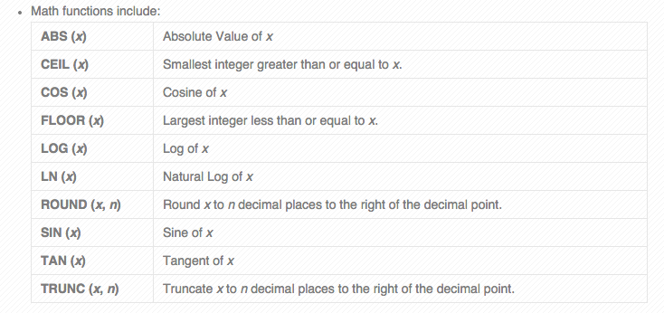
DUAL, Functions
SELECT TO_CHAR(SYSDATE, ‘DD-MON-YYYY HH:MM:SS’) FROM DUAL;

Slide 20
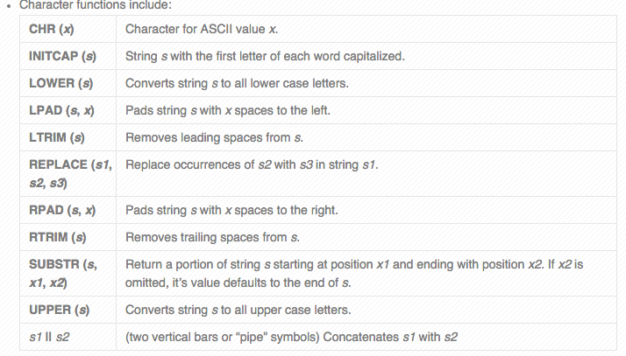

Slide 21
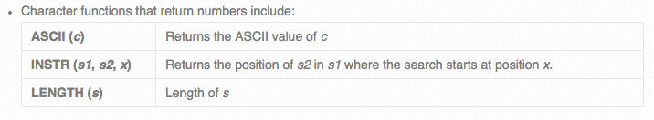
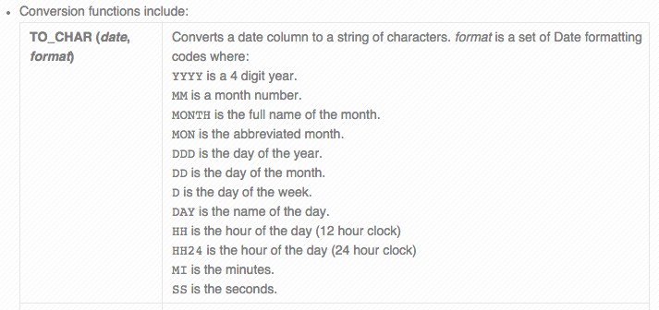

Slide 22
